Slide 1
Kernel –
Device Drivers (part 1)
CS 0449
Jarrett Billingsley

Slide 2
Class announcements
do lab 7 BEFORE trying to start project 3. trust me.
  ...and project 3 will be out this weekend.

Slide 3
Resource Allocation

Slide 4
Who took my remote
the OS, the overbearing micromanager that it is, keeps track of which process is using every resource on the system
each process has a list of resources that it's using
Process 1
index | Resource
0 | /dev/pts/1
1 | /dev/pts/1
2 | /dev/pts/1
3 | file1.txt
let's look at /dev/fd
Memory
stdin, stdout, stderr…
Code
opened another file
this is what the open() syscall really returns!
I'm glossing over how memory is allocated but it's similar
Notes:
- I mean, internally it could be a lot more complex, but the API gives the impression that you're getting array indices.

Slide 5
No touch-a my remote! (animated)
the OS is the arbiter of who gets to access what things, and when
Process 1
Process 2
Memory
file1.txt
blah blah blah. this is some text. I'm a file. wooooo
hey! delete file1.txt!!
Memory
3
Code
Code
whee I'm writing to file1.txt
woah woah woah. what? no. process 1 is using that.
oh… :(
lsof is a great shell command!
Kernel
Notes:
- see, the kernel isn't a dick, it just wants everyone to follow the rules.
- (but IRL that can be dickish so)

Slide 6
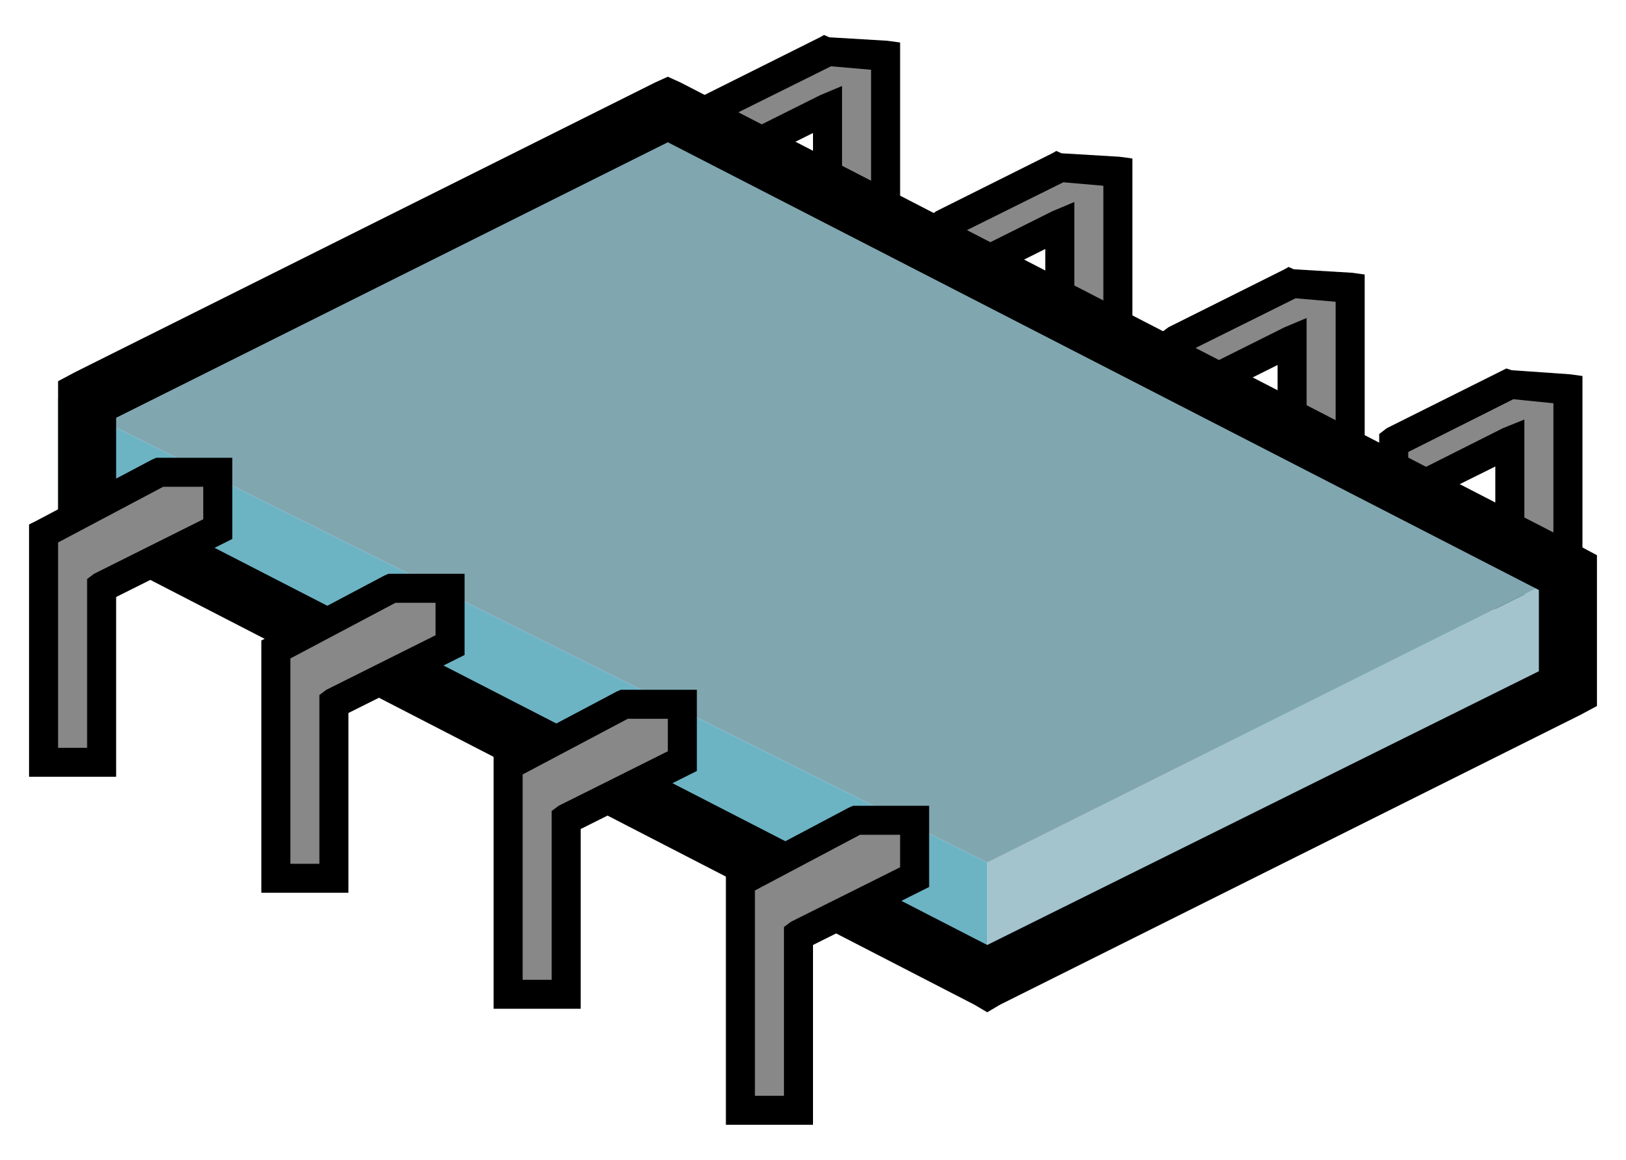
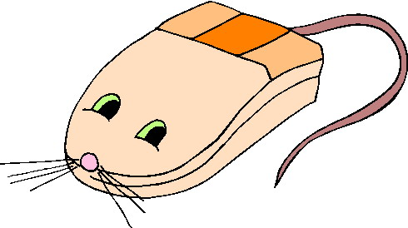





It's not just files
the OS keeps track of every resource like this
files
RAM
hardware
devices!
software
devices??

Slide 7
Limits
the sysadmin (system administrator) has the ability to put limits on resources that users/processes can have
the ulimit command lets you see and set those limits
  ulimit -a shows your limits
ulimit -u n is your best defense against forkbombing yourself!
  by default you can run up to 512562 processes
    this is absurd
  when you work on project 4, use e.g. ulimit -u 30
  it only lasts for this login; if you log into the thoth again, you're back to 512562 processes
  if you do forkbomb it, you will still need some help killing the processes, so let me know if you did that.

Slide 8
Kernel Modules

Slide 9

Cakes on cakes
remember the cake??
well the kernel has a whole buncha parts of its own
User
Space
Program code
Runtime
OS API
syscalls!!!
Kernel
Space
Syscall handler
Scheduler
Memory manager
Storage manager
Hardware access
scary low-level code to control the CPU
a hole
Notes:
- scheduler is responsible for deciding which process gets a turn next
- memory and storage managers are… pretty self explanatory
- low-level CPU control code is complicated stuff to control caches, hardware threading support, interrupts etc
- hardware access is all the stuff that talks to other hardware devices besides the CPU and memory

Slide 10
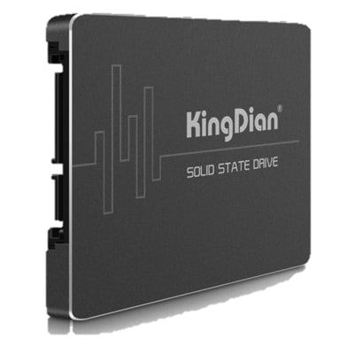
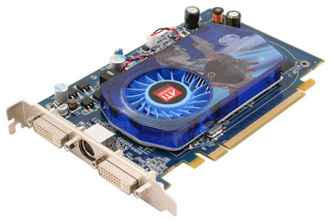
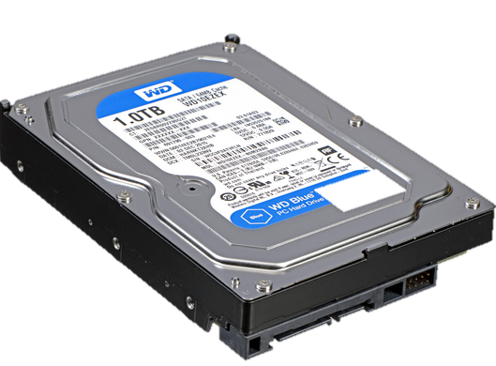
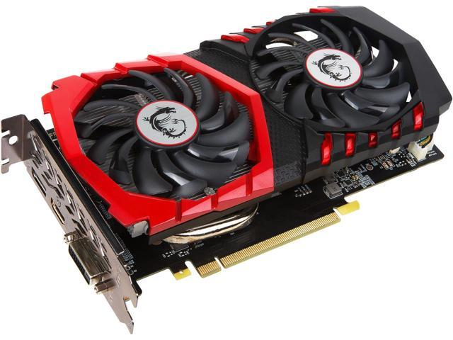
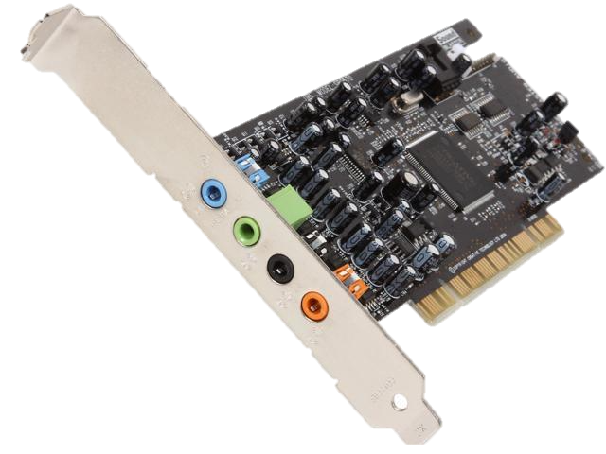
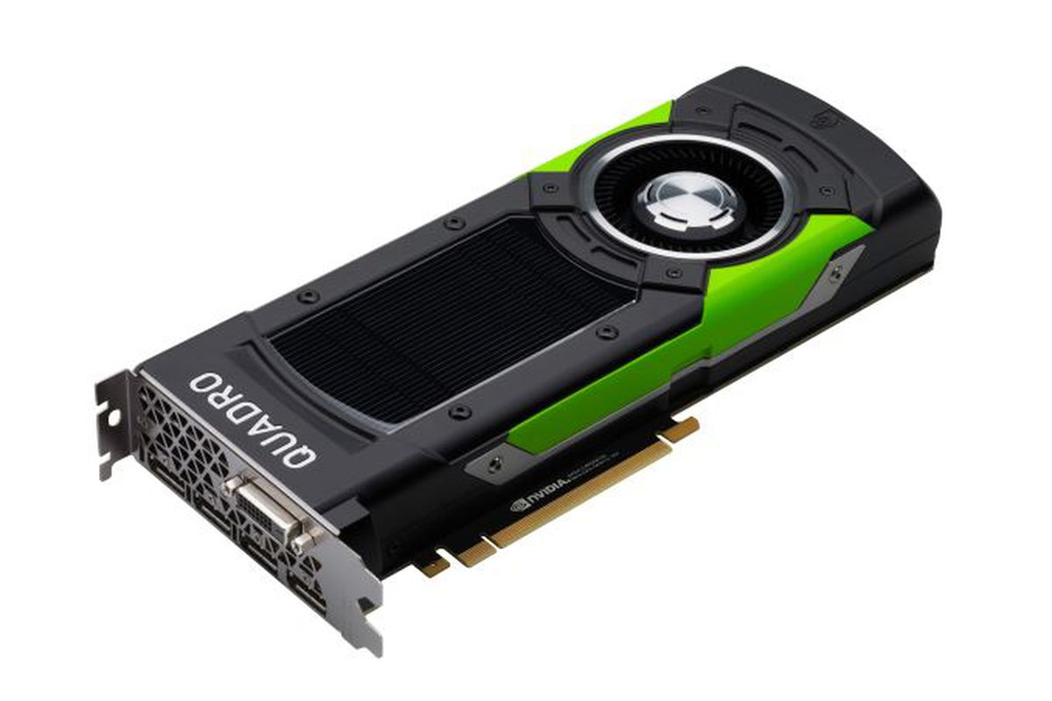
Plug 'N' Play
how many kinds of hardware can you think of?
I didn't wanna put a thousand images on here but you get the idea

Slide 11

Intractable
there are thousands upon thousands of pieces of hardware
each one works differently
it's completely impractical to "bake" code to control that hardware into the kernel itself
  the kernel would be hundreds of terabytes
  and most of it would go unused
Kernel
well… what did we do when we wanted to add functionality to a user-mode program?

Slide 12


Like plugins, but way scarier
many OS kernels support dynamic loading of kernel modules
  essentially, plugins for the kernel.
insmod foo.ko
Kernel
but what's scary about this?
where is this code executing?
foo.ko
.ko for "kernel object"
if a kernel module is evil or broken, you're gonna have a bad time.
Notes:
- the kernel module IS EXECUTING IN THE KERNEL, IN KERNEL MODE. that's terrifying

Slide 13
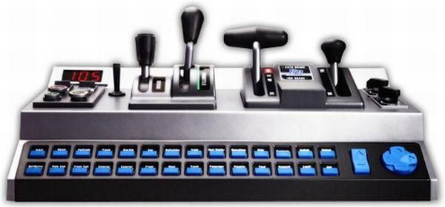
How it works
when a kernel module is loaded…
welcome to the kernel!
HAY GUISE!!!
Kernel
Module
yay! here are the things I can do:
ok, I'll let you know if anyone needs them.
handle_weirdo()
whatever()
more_stuff()
is that yours?
yeah…

Slide 14
Device Drivers

Slide 15
beep beep honk honk
a device driver is a kind of kernel module which allows the kernel to communicate with a piece of hardware. like a translator.
你明白我说的吗？
Kernel
what??
they said, "do you understand me?"
oh.
driver
“我爱你。”
…tell them I love them.
I think you blew it.

Slide 16
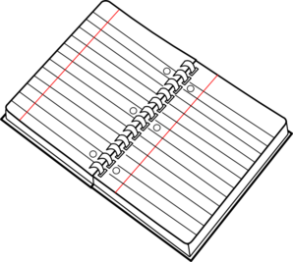

Kinds of devices
There are two broad classes of devices: pipes and notebooks.
  uh, I mean character and block devices.
Character
Block
they're like a pipe: one way, and the data goes through one byte at a time.
they're like a notebook: you can go to any location and access a bunch of data at once
data!
34
data!
words words words words words!
35
words words words words words!

Slide 17
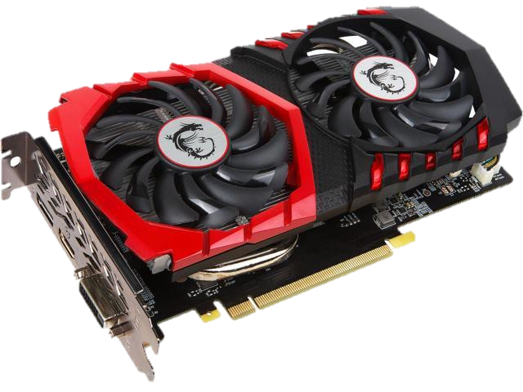
What do you think (animated)
which kind of device do you think each of these is?
Character
Block
RAM

Slide 18
If you have a hard time classifying something…
…either your classification scheme needs to be expanded
…or you should split up the complex thing into simpler parts.
commands
"data across time"
status
graphics RAM
"data across space"
configuration ROM
one hardware device, multiple software devices!

Slide 19
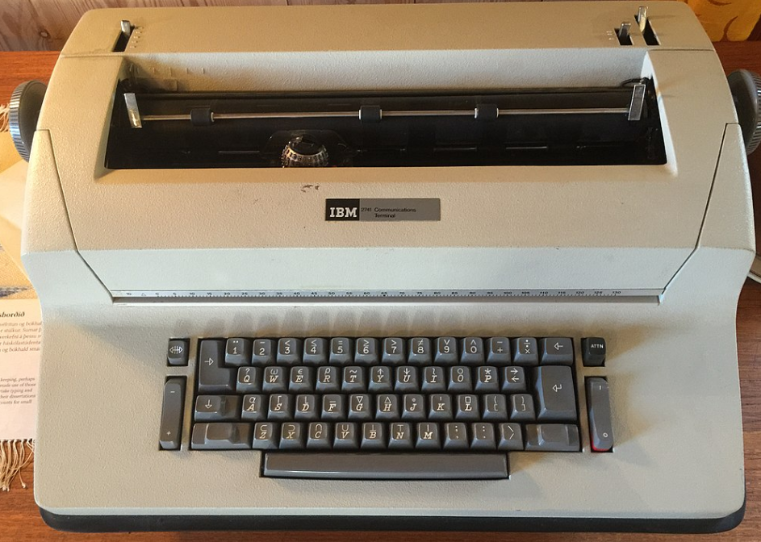
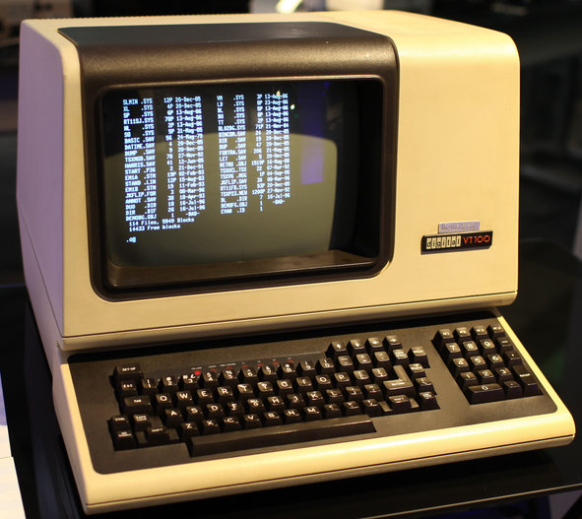
Software devices
it's also useful to have "devices" which aren't really "devices" at all
now we use terminal emulators (Terminal, PuTTY)
teletype machines let you log into remote computers
then came terminals
when you log into thoth, it gives you a tty: a teletype device
teletypes haven't existed for decades, but the OS doesn't care!
Notes:
- abstraction is cool y'all

Slide 20
The Kernel's
Virtual Filesystems

Slide 21
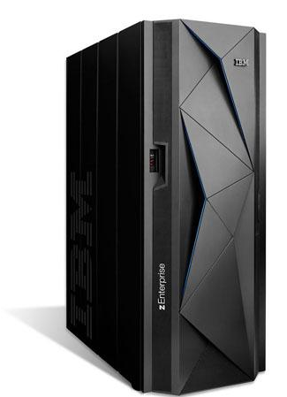
"File" system
the POSIX filesystem is just a way of organizing names.
virtual filesystems are directories which aren't on the hard drive.
internets
/afs/…
/bin/ls
AFS is a virtual filesystem that accesses data over the internet
this is transparent to the user! they're "just" files!
Notes:
- in the case of AFS, you're still accessing files, they just happen to be located elsewhere.
- but the abstraction of the filesystem lets us pretend like they're local files.

Slide 22

Opening new doors
syscalls are fixed: you can't add new ones. but there's a loophole…
when we load cats.ko, it creates a device named /dev/cats.
when we open /dev/cats, we're opening a communication channel to cats.ko.
User Space
and when we read, we're really getting data from cats.ko!
open("/dev/cats")
read(...)
/dev/cats
Kernel
Space
cats.ko
Storage manager
Syscall handler
Notes:
- for example, you can get a stream of random bytes from /dev/urandom
- head -c 100 /dev/urandom > file
- that will make a 100 byte file filled with random bytes
- or you can redirect output to /dev/null and it will disappear forever……………………..

Slide 23
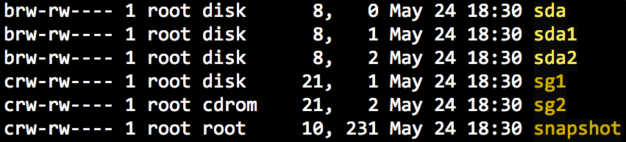
/dev/
/dev/ is the directory of devices, hardware and software.
this column says block or character
these are the device numbers
the major number says "which kernel module created this device?"
sort of
the minor number is used by the kernel module to identify all the devices it made
Notes:
- ofc the major/minor numbers have themselves been abstracted, so it's possible for one module to have multiple major numbers for instance
- hey, there's /dev/stdin… it's just a symlink to the device that's standard input for the current process.

Slide 24
/proc/
oh boy. this has a lot of crap in it
the numbered directories are processes. they're the pids!
  if you list one you'll see all sorts of stuff…
  you can cat or less many of these "files" to get info
  the fd/ directory shows all open file descriptors – there's 0, 1, 2!
but then… they started dumping a bunch of other stuff in /proc/
  you can see the CPU info with /proc/cpuinfo
  you can see the OS version with /proc/version
  /proc/modules shows all the currently-loaded kernel modules
then they were like "maybe we should stop throwing things in /proc"

Slide 25
/sys/
a more modern way of accessing kernel features
it's much more hierarchical.
/sys/module/*/parameters are module "options"
  these wouldn't make sense as a device
  but these are how your control panel might do things like set how long your screen stays on until it sleeps
most of the stuff in /sys/ is pretty opaque to a normal user…

Slide 26
In summary
when a kernel module is loaded…
  it can create one or more devices which appear in /dev/
  it can create parameters which appear in /sys/module/
  you can interact with it through those files
the kernel itself also places things in /dev/, /proc/, and /sys/
this is all super flexible because everything is a file!
  no need to add a million syscalls!

